Slide 1
Applied Data Science Decision Trees And Random Forest
Dr. Omri Allouche
2017

Slide 2
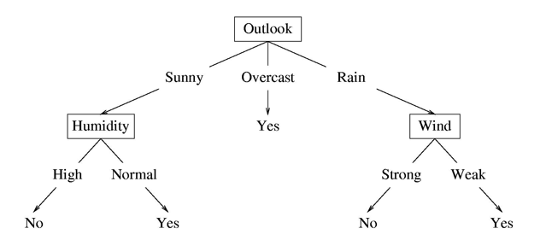
Example Tree
Basic idea:
Choose the best attribute(s) to split the remaining instances and make that attribute a decision node
Repeat this process for recursively for each child
Stop when:
All the instances have the same target attribute value
There are no more attributes
There are no more instances

Slide 3
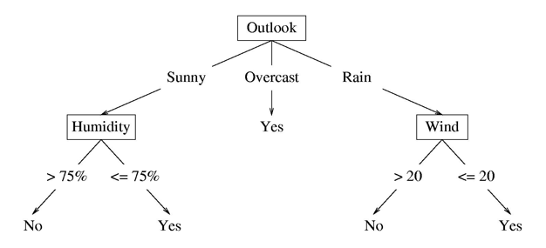
Splitting Continuous Variables

Slide 4
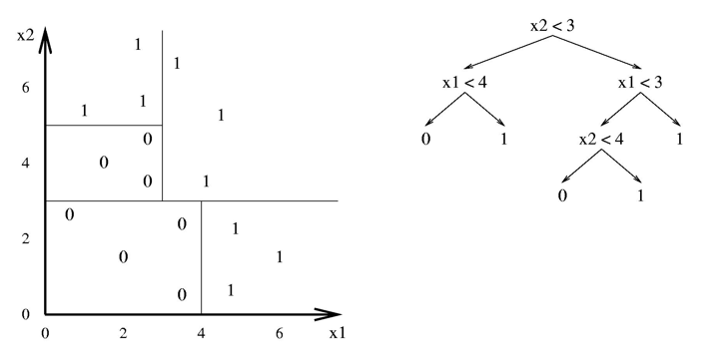
Splits for rectangles in hyperspace

Slide 5
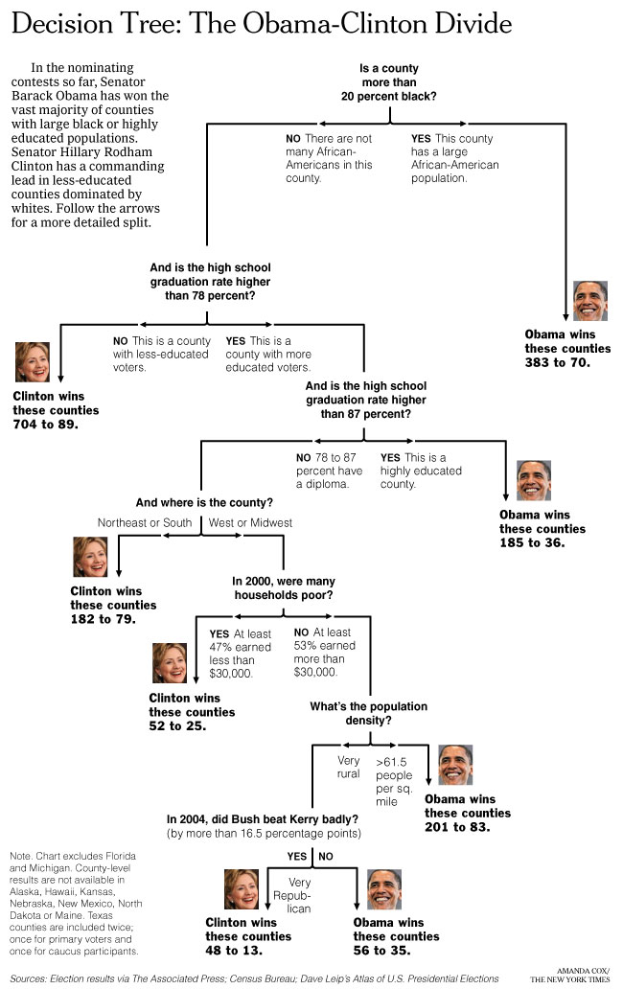
New York Times
April 16, 2008

Slide 6
How many decision trees are possible?
Given N Boolean features:
2^{N} Boolean functions
2^(2^{N}) truth tables

Slide 7
Expressiveness
Decision trees can express any Boolean function.
The problem: There exists a tree that “memorizes” our observations’ value
We want a compact tree (following Occam’s Razor) – find one is NP-hard

Slide 8
Expressiveness: Boolean Function with 2 attributes → 2²² DTs
AND
OR
A
XOR
A
A
A
A
T
F
T
F
T
F
T
F
B
B
B
B
B
B
B
B
T
F
T
F
T
F
T
F
T
F
T
F
T
F
T
F
T
F
F
F
T
T
T
F
F
T
T
F
T
T
F
F
NAND
NOR
A
XNOR
NOT A
A
A
A
T
F
T
F
T
F
T
F
B
B
B
B
B
B
B
B
T
F
T
F
T
F
T
F
T
F
T
F
T
F
T
F
F
T
T
T
F
F
F
T
F
T
F
T
F
F
T
T

Slide 9
Expressiveness: Boolean Function with 2 attributes → 2²² DTs
AND
OR
A
XOR
A
A
A
A
T
F
T
F
T
F
T
F
B
T
B
B
B
T
F
F
T
F
T
F
T
F
T
F
T
F
T
F
F
T
T
F
NAND
NOR
A
XNOR
NOT A
A
A
A
T
F
T
F
T
F
T
F
B
T
F
B
B
B
F
T
T
F
T
F
T
F
T
F
F
T
F
T
F
T
F
T

Slide 10
Expressiveness: Boolean Function with 2 attributes → 2²² DTs
A AND-NOT B
NOT A AND B
B
TRUE
A
A
A
A
T
F
T
F
T
F
T
F
B
B
B
B
B
B
B
B
T
F
T
F
T
F
T
F
T
F
T
F
T
F
T
F
F
T
F
F
F
F
T
F
T
F
T
F
T
T
T
T
A OR NOT B
NOR A OR B
NOT B
A
FALSE
A
A
A
T
T
F
T
F
T
F
F
B
B
B
B
B
B
B
B
T
F
T
F
T
F
T
F
T
F
T
F
T
F
T
F
T
F
T
T
T
T
F
T
F
T
F
T
F
F
F
F

Slide 11
Choosing the Best Split

Slide 12
Expressiveness: Boolean Function with 2 attributes → 2²² DTs
A AND-NOT B
NOT A AND B
B
TRUE
A
A
B
T
T
F
T
F
T
F
B
F
F
B
T
F
T
F
T
F
F
T
T
F
A OR NOT B
NOR A OR B
NOT B
FALSE
F
A
A
B
T
F
T
F
T
F
B
T
T
B
T
F
T
F
T
F
T
F
F
T

Slide 13
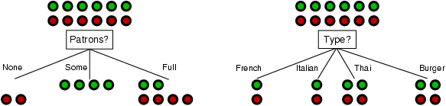
Choosing the Best Split
Use a Greedy Algorithm – choose the most significant split
No backtracking
Extensions and improvements in algorithms ID3, C4.5

Slide 14
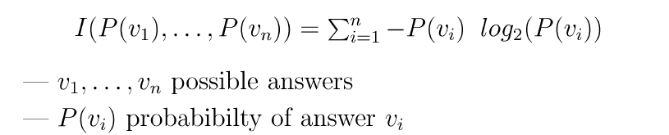
Entropy
Measures the “randomness” of an arbitrary collection of examples
Entropy increases when distribution is uniform, and is 0 when there is only a single value possible
1
0
0
1/2
1
p

Slide 15
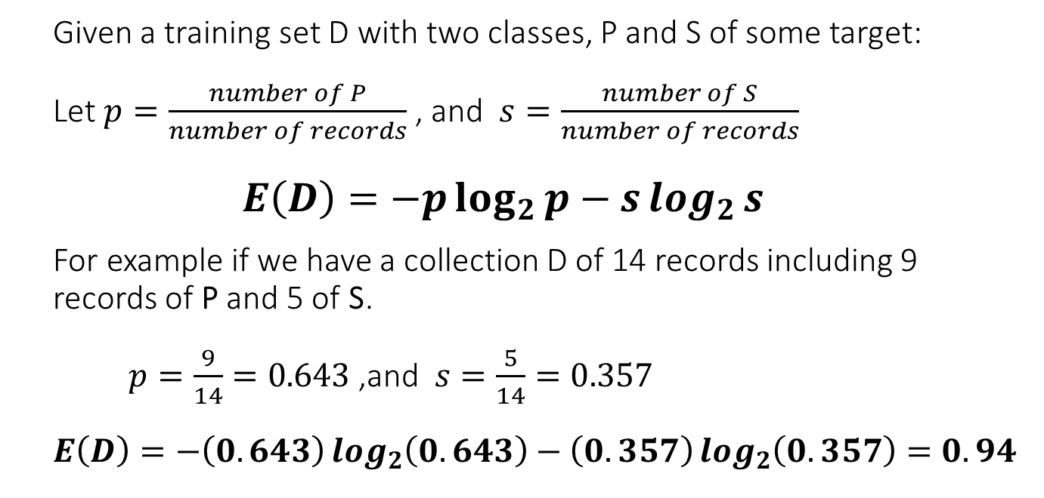
Entropy
# | Decision
1 | P
2 | S
3 | P
4 | S
5 | P
6 | P
7 | P
8 | S
9 | S
10 | P
11 | P
12 | S
13 | P
14 | P
Given a training set D with two classes, P and S of some target:
Let $p=\frac{number of P}{number of records}$ , and $s=\frac{number of S}{number of records}$
$$E\left(D\right)=−p\log_{2}{p}−s\log_{2}{s}$$
For example if we have a collection D of 14 records including 9 records of P and 5 of S.
$p=\frac{9}{14}=0.643$ ,and $s=\frac{5}{14}=0.357$
$$E\left(D\right)=−\left(0.643\right)\log_{2}\left(0.643\right)−\left(0.357\right)\log_{2}\left(0.357\right)=0.94$$

Slide 16


Information Gain
measure the information gain after testing a given attribute A:
Remainder(A) → gives us the remaining uncertainty after getting info on attribute A.

Slide 17
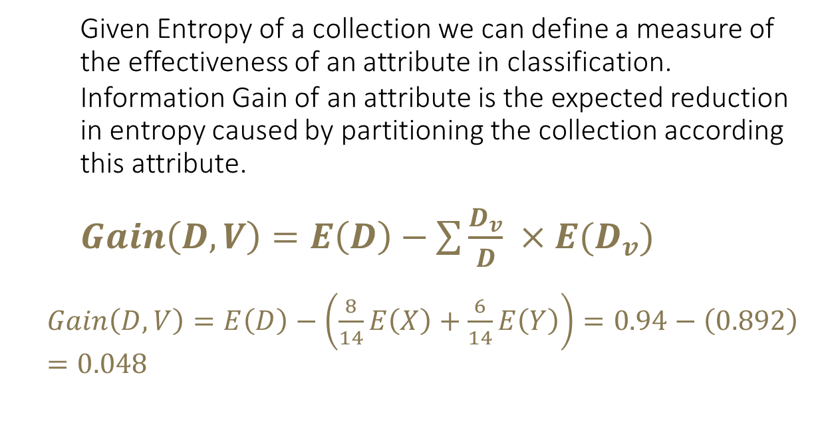
Information Gain
# | Decision | Att. (V)
1 | P | X
2 | S | X
3 | P | Y
4 | S | Y
5 | P | X
6 | P | X
7 | P | X
8 | S | Y
9 | S | X
10 | P | Y
11 | P | X
12 | S | Y
13 | P | Y
14 | P | X
Given Entropy of a collection we can define a measure of the effectiveness of an attribute in classification.
Information Gain of an attribute is the expected reduction in entropy caused by partitioning the collection according this attribute.
$Gain\left(D,V\right)=E\left(D\right)−\sum{\frac{D_{v}}{D} ×E(D_{v})}$
$Gain\left(D,V\right)=E\left(D\right)−\left(\frac{8}{14}E\left(X\right)+\frac{6}{14}E\left(Y\right)\right)=0.94−\left(0.892\right)=0.048$

Slide 18
Gini Index
Used in CART, SLIQ, SPRINT to determine the best split.
Tree Growing Process:
Find each predictor’s best split.
Find the node’s best split : Among the best splits found in step 1, choose the one that maximizes the splitting criterion.
Split the node using its best split found in step 2 if the stopping rules are not satisfied.

Slide 19
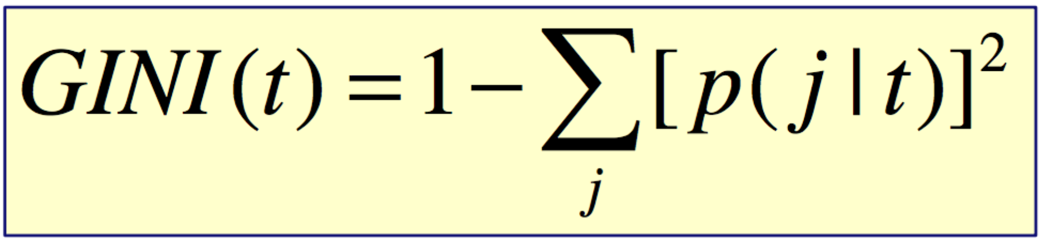
Finding the Best Split: GINI Index
GINI Index for a given node t:
p(j|t) is the relative frequency of j at node t
Maximum (1-1/n): records equally distributed in n classes
Minimum 0: all records in one class
Notes:
http://saiconference.com/Downloads/SpecialIssueNo10/Paper_3-A_comparative_study_of_decision_tree_ID3_and_C4.5.pdf
http://research.ijcaonline.org/volume117/number16/pxc3903318.pdf

Slide 20
Computing The GINI Index
C1 | 0
C2 | 6
P(C1) = 0/6 = 0, P(C2) = 6/6=1
GINI = 1 - P(C1)² - P(C2)² = 1 - 0 - 1 = 0
C1 | 2
C2 | 4
P(C1) = 2/6 = 1/3, P(C2) = 4/6=2/3
GINI = 1 - (1/3)² - (2/3)² = 0.444
C1 | 3
C2 | 3
P(C1) = 3/6 = 1/2, P(C2) = 3/6 = 1/2
GINI = 1 - (1/2)² - (1/2)² = 1 - 1/4 - 1/4 = 0.5
Notes:
http://saiconference.com/Downloads/SpecialIssueNo10/Paper_3-A_comparative_study_of_decision_tree_ID3_and_C4.5.pdf
http://research.ijcaonline.org/volume117/number16/pxc3903318.pdf

Slide 21
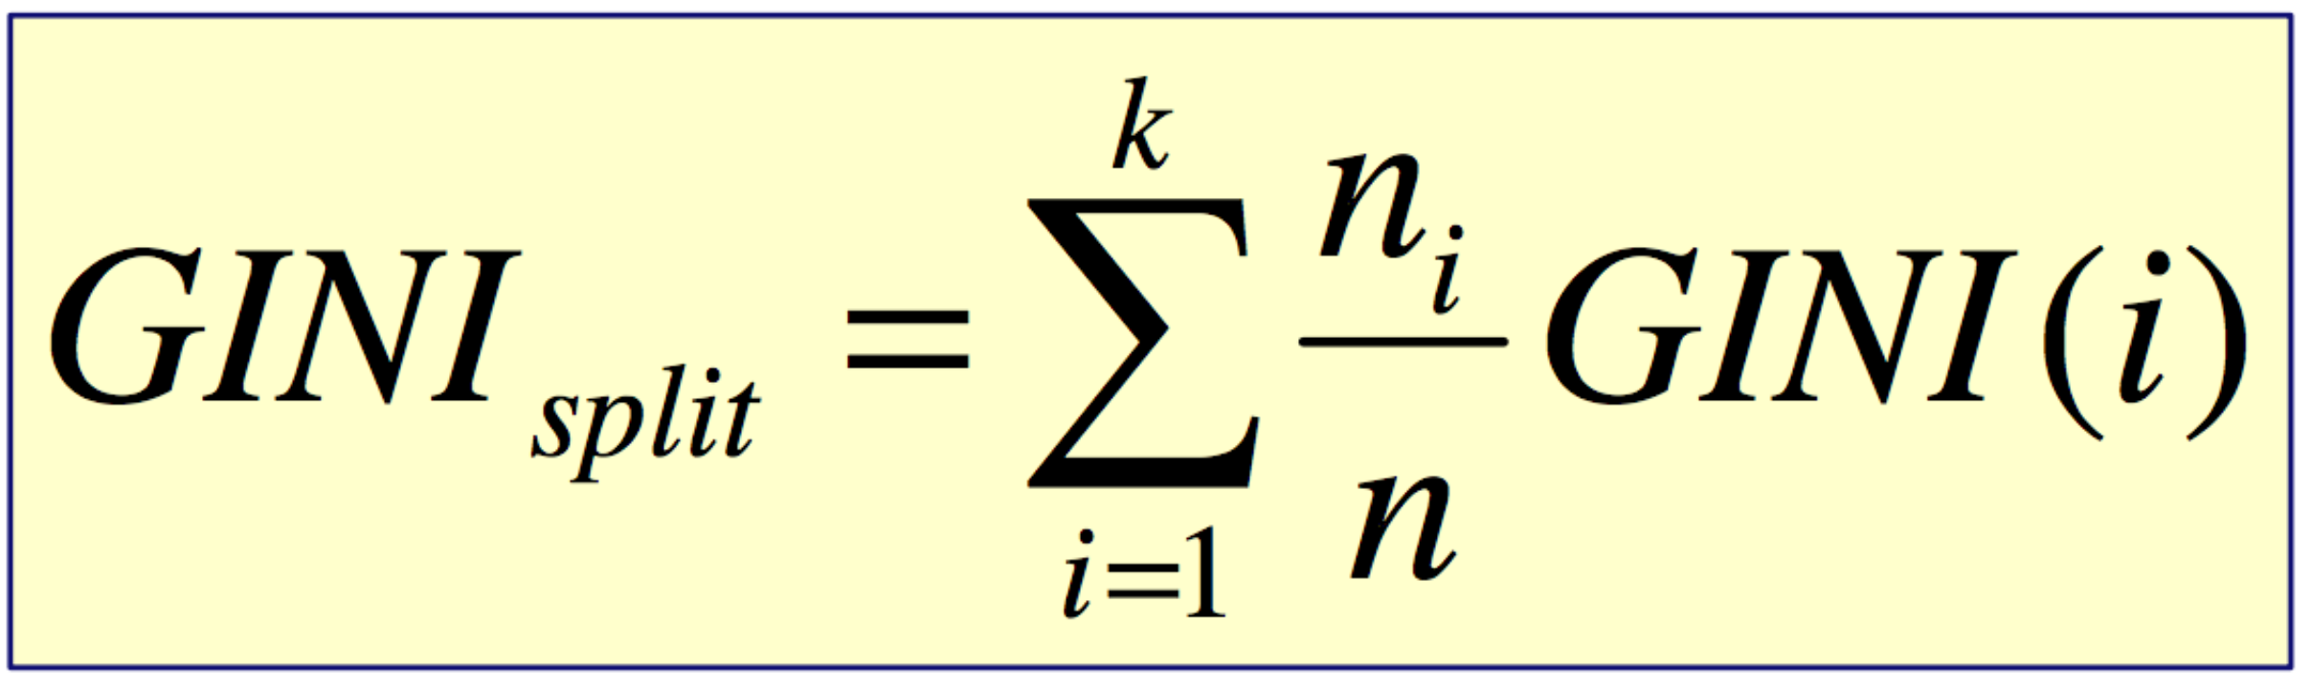
Finding the Best Split: GINI Index
When a node p is split into k partitions (children), the quality of split is computed as:
ni = number of records at child i,
n = number of records at node p
Notes:
http://saiconference.com/Downloads/SpecialIssueNo10/Paper_3-A_comparative_study_of_decision_tree_ID3_and_C4.5.pdf
http://research.ijcaonline.org/volume117/number16/pxc3903318.pdf

Slide 22
Computing GINI Index for Binary Attributes
Splits into two partitions
Effect of Weighing partitions: Larger and Purer Partitions are sought for.
Example (wind condition in nadal example):
GINI(Weak) = 1 - (7/9)² - (2/9)² = 0.346
GINI(Strong) = 1 - (2/5)² - (3/5)² = 0.48
GINI(Children) = 9/14 * 0.346 + 5/14 * 0.48
= 0.393
Wind? | Weak | Strong
Play | 7 | 2
Stay | 2 | 3
Gini | 0.346 | 0.48
Gini(Children) = 0.393
Notes:
http://saiconference.com/Downloads/SpecialIssueNo10/Paper_3-A_comparative_study_of_decision_tree_ID3_and_C4.5.pdf
http://research.ijcaonline.org/volume117/number16/pxc3903318.pdf

Slide 23
Computing GINI Index for Categorical Attributes
Multiway Split
For each distinct value, gather counts for each class in the dataset
Example (temperature condition in nadal example):
GINI(Hot) =1 - (3/4)² - (1/4)² = 0.375
GINI(Mid) = 1 - (3/5)² - (2/5)² = 0.48
GINI(Cold) = 1 - (3/5)² - (2/5)² = 0.48
GINI(Children) = 4/14 * 0.375
+ 5/14 * 0.48
+ 5/14 * 0.48
= 0.45
Temp.? | Hot | Med | Cold
Play | 3 | 3 | 3
Stay | 1 | 2 | 2
Gini | 0.375 | 0.48 | 0.48
Gini(Children) = 0.45
Notes:
http://saiconference.com/Downloads/SpecialIssueNo10/Paper_3-A_comparative_study_of_decision_tree_ID3_and_C4.5.pdf
http://research.ijcaonline.org/volume117/number16/pxc3903318.pdf

Slide 24
Computing GINI Index for Categorical Attributes
Two way Split
Join 2 or more nodes so we have only 2 nodes
Example (outlook condition in nadal example):
Two way split will result in a larger gini index because it merge purer subsets resulting in more impure new set
Temp.? | Hot | Med/Cold
Play | 3 | 6
Stay | 1 | 4
Gini | 0.375 | 0.48
Gini(Children) = 0.45
Temp.? | Hot/Med | Cold
Play | 6 | 3
Stay | 3 | 2
Gini | 0.444 | 0.48
Gini(Children) = 0.457
Temp.? | Hot/Cold | Med
Play | 6 | 3
Stay | 3 | 2
Gini | 0.444 | 0.48
Gini(Children) = 0.457
Notes:
http://saiconference.com/Downloads/SpecialIssueNo10/Paper_3-A_comparative_study_of_decision_tree_ID3_and_C4.5.pdf
http://research.ijcaonline.org/volume117/number16/pxc3903318.pdf

Slide 25
Computing GINI Index for Continuous Attributes
Assume we have a continuous attribute weight which ranges from 60-100 kg:
It would be computationally expensive to go through the data set scanning to see what values are below w for each value of w
Instead of brute force approach, we sort the data based on the weight attribute
Then choose a candidate split position that are identified by taking the midpoints between two adjacent sorted values
And employ a split approach using these values as we did in categorical attributes
Notes:
http://saiconference.com/Downloads/SpecialIssueNo10/Paper_3-A_comparative_study_of_decision_tree_ID3_and_C4.5.pdf
http://research.ijcaonline.org/volume117/number16/pxc3903318.pdf

Slide 26
Treating Missing Data in Trees
Missing values are common in practice
Approaches to handing missing values
During training
Ignore rows with missing values (inefficient)
During testing
Send the example being classified down both branches and average predictions
Replace missing values with an “imputed value” (can be suboptimal)
Other approaches
Treat “missing” as a unique value (useful if missing values are correlated with the class)

Slide 27
How to Choose the Right-Sized Tree?
Predictive
Error
Error on Test Data
Error on Training Data
Size of Decision Tree
Ideal Range
for Tree Size

Slide 28
Choosing a Good Tree for Prediction
General idea
grow a large tree
prune it back to create a family of subtrees
“weakest link” pruning
score the subtrees and pick the best one
Massive data sizes (e.g., n ~ 100k data points)
use training data set to fit a set of trees
use a validation data set to score the subtrees
Smaller data sizes (e.g., n ~1k or less)
use cross-validation

Slide 29
Avoiding Overfit
Preprunning – stop when information gain is small
Postprunning – develop a full tree, then prune it
Subtree pruning
Subtree replacement

Slide 30
Pros and Cons
Easy to interpret (when the number of nodes is small)
Relatively fast to build
Very fast during prediction phase
Works with both categorical+numerical values
Good with high dimensional data
Robust to noisy data
Simple to implement
Prone to overfitting
Splits based on a single feature each time
Harder to train incrementally (with new batch of observations)

Slide 31
Limitations of Classification Trees
Representational Bias
piecewise linear boundaries, parallel to axes
High Variance
trees can be “unstable” as a function of the sample
e.g., small change in the data -> completely different tree
causes two problems
1. High variance contributes to prediction error
2. High variance reduces interpretability
Trees are good candidates for model combining
Often used with boosting and bagging
Trees do not scale well to massive data sets (e.g., N in millions)
repeated random access of subsets of the data

Slide 32
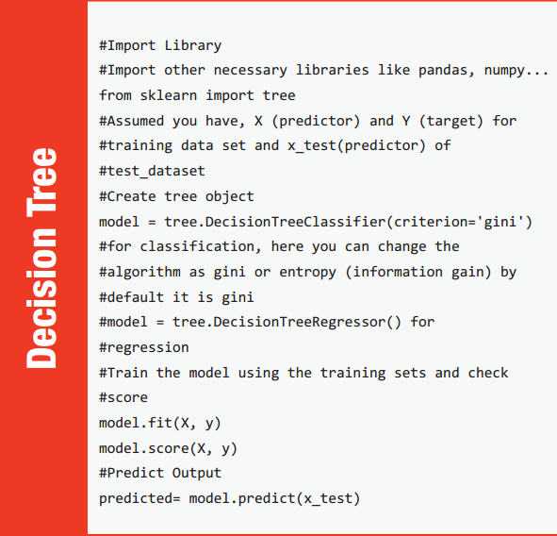

Slide 33
Boosted Trees and Random Forest

Slide 34
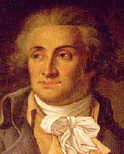
Condorcet’s jury theorem
Let consider a group of M voters.
If each voter has an independent probability p > 1/2 of voting for the correct decision, then adding more voters increases the probability of the majority decision to be correct.
When M → ∞, the probability that the decision taken by the group is correct approaches 1.

Slide 35
Using Boosted Decision Trees
Flexible: can deal with both continuous and categorical variables
How to control bias/variance trade-off
Size of trees
Number of trees
Boosting trees often works best with a small number of well-designed features
Boosting “stubs” can give a fast classifier

Slide 36

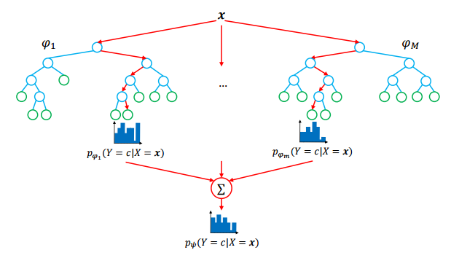
rANDOMIZATION

Slide 37
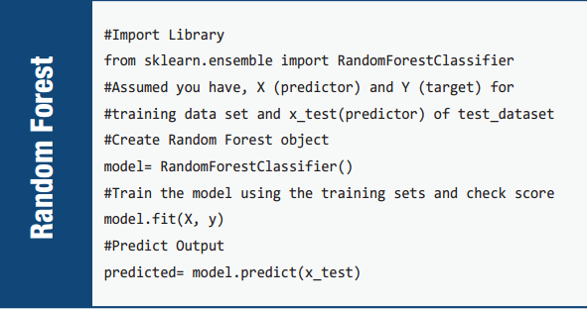

Slide 38
Variable Importance

Slide 39
Variable Importance
Interpretability can be recovered through variable importances
• Two main importance measures :
The mean decrease of impurity (MDI) : summing total impurity reductions at all tree nodes where the variable appears (Breiman et al., 1984) ;
The mean decrease of accuracy (MDA) : measuring accuracy reduction on out-of-bag samples when the values of the variable are randomly permuted (Breiman, 2001).
• We focus here on MDI because :
It is faster to compute ;
It does not require to use bootstrap sampling ;
In practice, it correlates well with the MDA measure

Slide 40
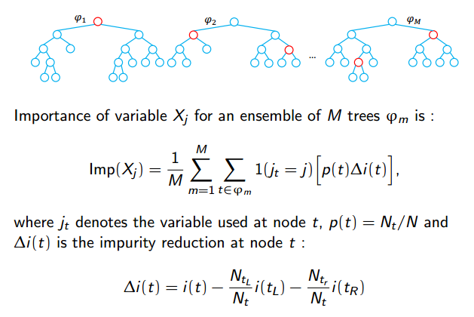

Slide 41
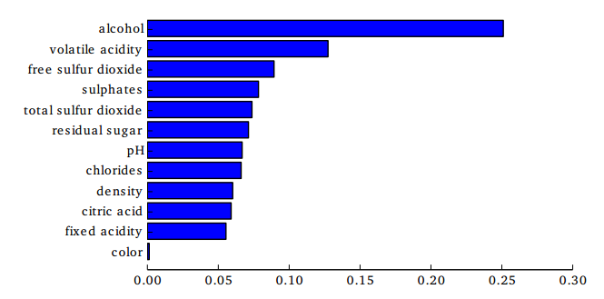
Feature Importance

Slide 42
Pros and Cons
One of the most robust and effective machine learning algorithms
Simple in design and easy to use
Works well for both classification and regression problems
Requires almost no data preparation
Can be used for feature selection
Highly parallelizeable
Doesn’t scale very well
Hard to analyze theoretically
Non-trivial to interpret
Difficult to implement properly

Slide 43
Boosting
A tree is fitted to the residuals of the first tree, and so on
Later trees depend on the results of previous trees
Gradient Boosting Trees work very well out of the box
Frequent winner in Kaggle competitions

